Slide 1
P1MMO GAME
3조 김동현 서현석 박윤하 박윤서

Slide 2
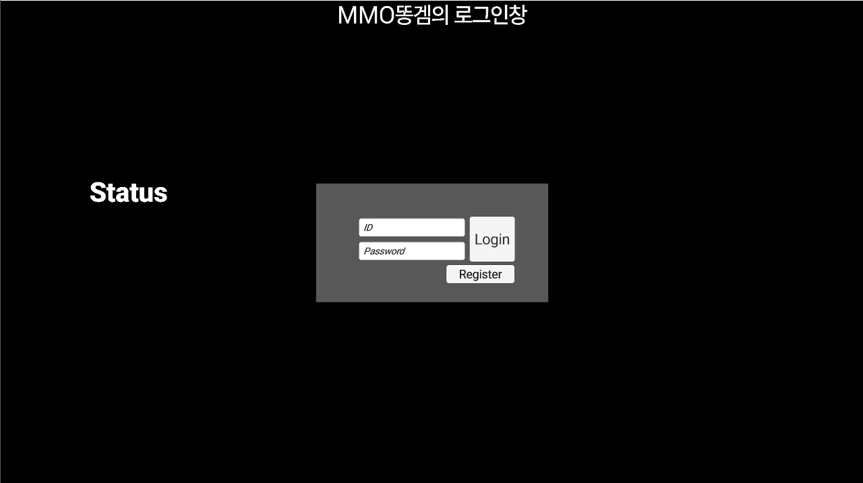

Slide 3
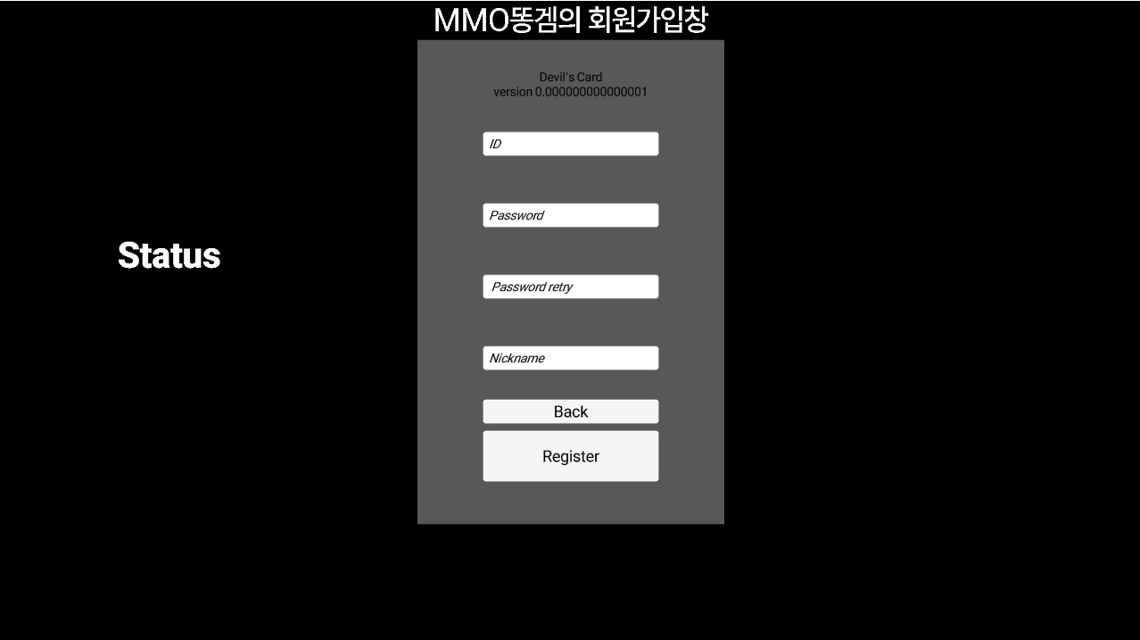

Slide 4
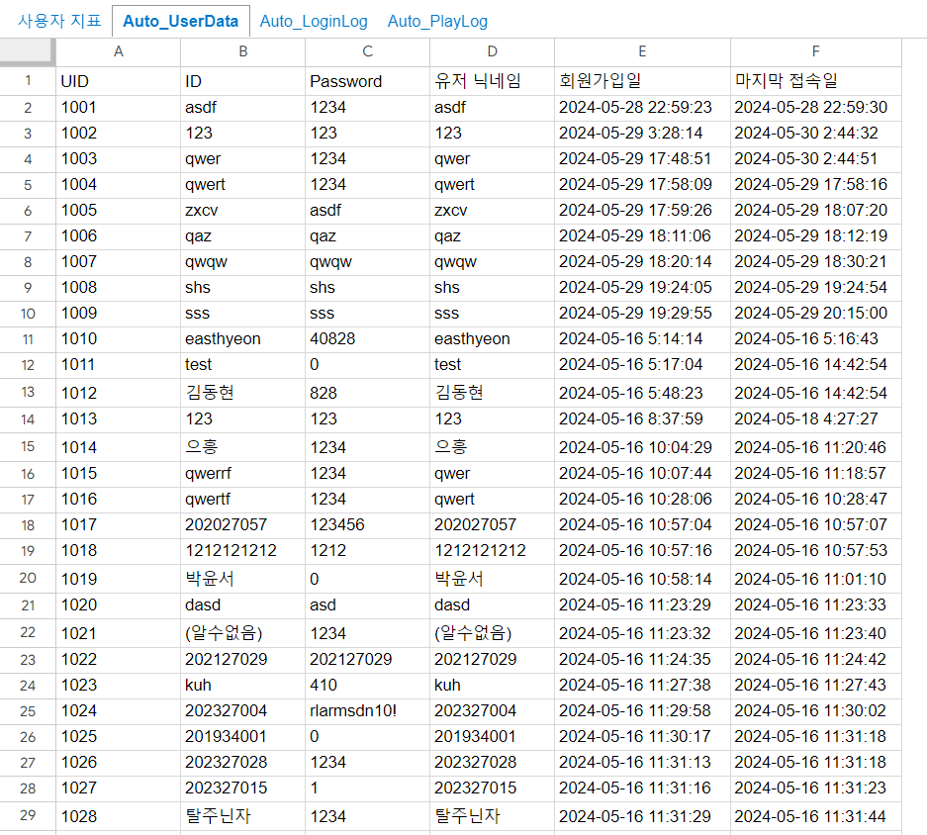

Slide 5
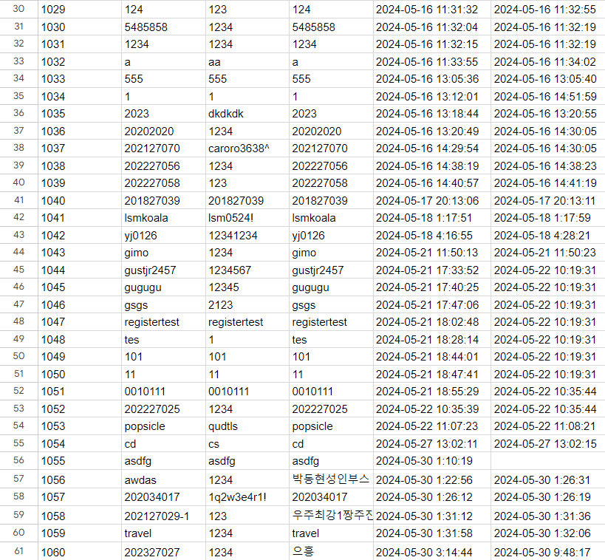

Slide 6
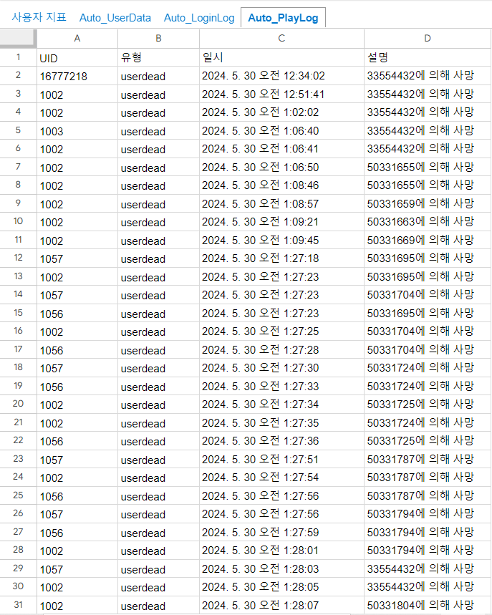
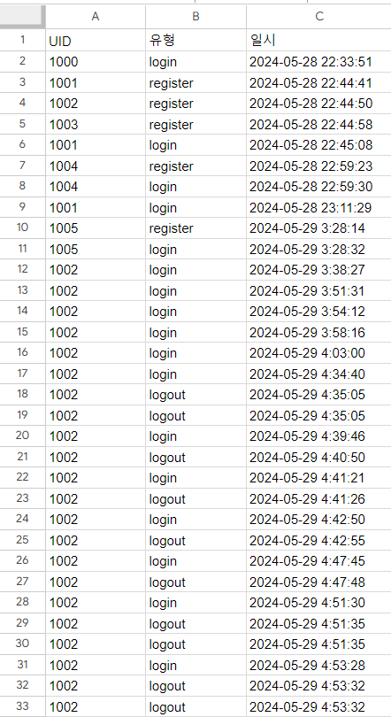
https://docs.google.com/spreadsheets/u/0/d/16feKB5iMB7abHiWgz5pFegdbceKS_wVCEdRxVfjJNGc/htmlview#

Slide 7
